Slide 1
Zorg Advies Beleid- Aedes & arboviruses
Veerle Vanlerberghe, Isra Deblauwe, Marjan Van Esbroeck, Wim Van Bortel, Phoebe Okeson, Matthew Watts, Ulla Maniewski-Kelner
vvanlerberghe@itg.be

Slide 2
Voorbereidend advies – how to avoid/limit arbovirus transmission
1- Voorstel tot acties voor bestrijding/controle van tijgermuggen in de Belgische context om (potentiële) transmissie te voorkomen:
Wetenschappelijke literatuurstudie en consultaties van de verantwoordelijken in de buurlanden omtrent bestrijdingsmethodes (muggenreductie/reductie mug-menscontact), hun efficiëntie en de gezondheidswinst (t.o.v. de kostprijs en de kost voor de omgeving) indien deze informatie voorhanden is.
Opstellen van een voorstel tot specifieke bestrijdingsacties (in tijd en ruimte) van de tijgermug in functie van de verschillende scenario’s met het oog op het onmiddellijk voorkomen van arbovirus-transmissie in geval van importgeval (Scenario 2* (+ importgeval) en Scenario 3 (+ importgeval) of autochtone gevallen (Scenario 4 en 5)
2- Voorstel tot maatregelen m.b.t. een geïntegreerde aanpak (detectie- en beschermingsmaatregelen), ter preventie van transmissie vanuit een arbovirusinfectie bij een teruggekeerde reiziger (dengue, (Zika, chikungunya)) om te voorkomen dat de ziekte zich verspreidt binnen een regio bij scenario 2* (+ importgeval), scenario’s 3 (+ importgeval), en bij uitbreiding scenario 4 of 5:
Wetenschappelijke literatuurstudie en consultaties van de verantwoordelijken in de buurlanden omtrent geïntegreerde aanpak, hun geschatte effectiviteit op vlak van transmissiepreventie en de indien de informatie aanwezig is, de gezondheidswinst (t.o.v. de haalbaarheid).
Opstellen van een voorstel tot specifieke geïntegreerde aanpak (detectie- en beschermingsmaatregelen) en stappenplan om verspreiding vanuit een (potentieel) geïmporteerd geval te voorkomen in geval van een scenario 2* (+ importgeval) en scenario 3 (+ importgeval). Met verschillende niveaus: acties zorgverleners en andere stakeholders mbt: terugkerende reizigers uit hoog endemische gebieden, mogelijk importgeval, bevestigd importgeval, omwonenden bevestigd geval, in een plaats waar tijgermuggen gevonden werden (met risico op introductie virus, als proxy voor asymptomatisch geval).
Opstellen van een voorstel tot specifieke preventiemaatregelen om verspreiding vanuit een (potentieel) autochtoon geval te voorkomen in geval van een Scenario 4 en 5 en dit op verschillende niveaus (mogelijk autochtoon geval, bevestigd autochtoon geval, omwonenden bevestigd geval).

Slide 3
Scenarios Belgium
Scenario 0: geen melding van tijgermug, risico op introductie tijgermug (gemeente niveau)
Scenario 1: melding van tijgermug - nieuwe locatie
Scenario 2: melding van tijgermug - gekende locatie laatste 5 jr - < 25km² (lokale vestiging mug)
Scenario 3: tijgermug wijdverspreid – zone > 25 km²
Scenario 4: autochtoon geval
Scenario 5: lokale uitbraak
*Scenarios 1-3, er bestaat risico op import virus door traveller

Slide 4
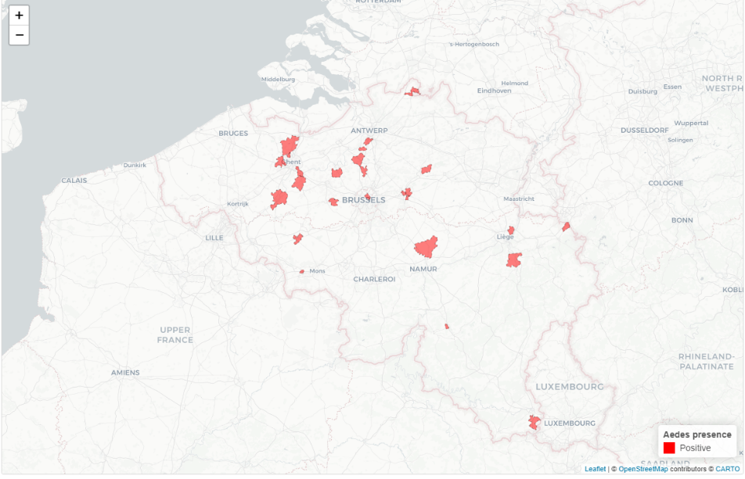
Aedes albopictus 2023 positive locations at post code level: Scenarios 1 (2023)

Slide 5
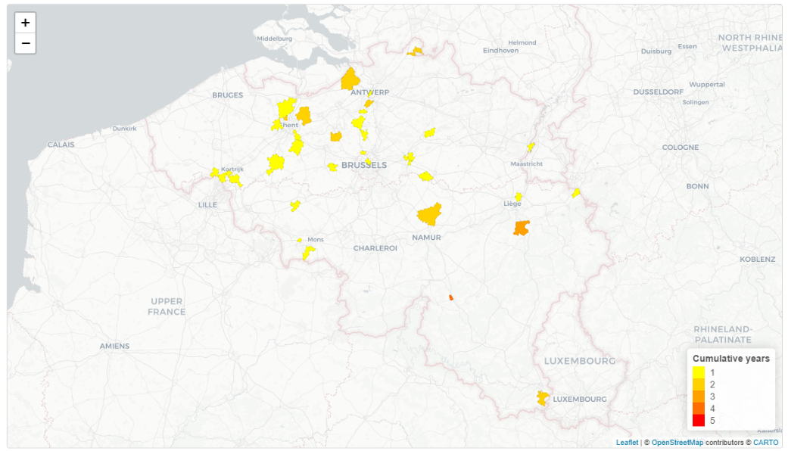
Cumulative mosquitoes over the last 5 years: indication of places being once/twice/3x/4X or 5x positive for presence of Aedes albopictus: Scenario 2 2024 (all but yellow zones) Wilrijk & Lebbeke (established)

Slide 6
Design prevention and/or control strategy to avoid/limit arbovirus transmission
Where do we have highest potential risk of transmission?
Challenge of incomplete data:
Aedes:
no full coverage of surveillance (mix of active and passive surveillance)
Available:
information over last 5 years on post codal level (baseline distribution) - since 2012, but until 2021 only from Points of entry
Scenarios (based on mosquito data)
Real-time data on post-codal level per month (and more precise) – probably to work with year data
Import arbovirus-cases (>> dengue)
No information on asymptomatic + under-diagnosis of symptomatic cases
Available:
Information over last 5 years on post codal level (PCR/IgM) per month (seasonal cases vs winter)
Real-time data on post-codal level (and more precise) per month (PCR/IgM) – to work with precise date

Slide 7
Design prevention and/or control strategy to avoid/limit arbovirus transmission
Where and when to act? Pro-active or reactive control strategy?
Reactive = control reactive to a risk
Risk:
An import case
A mosquito detected
when case and mosquito overlap temporally and spatially
(Autochtonous case or cluster of cases)
Approximately what would this mean for 2023?
We made a simulation with ‘cumulative data of import cases in transmission season’

Slide 8

Aedes albopictus 2023 positive locations at post code level: Scenarios 1 & 2 (2023)

Slide 9
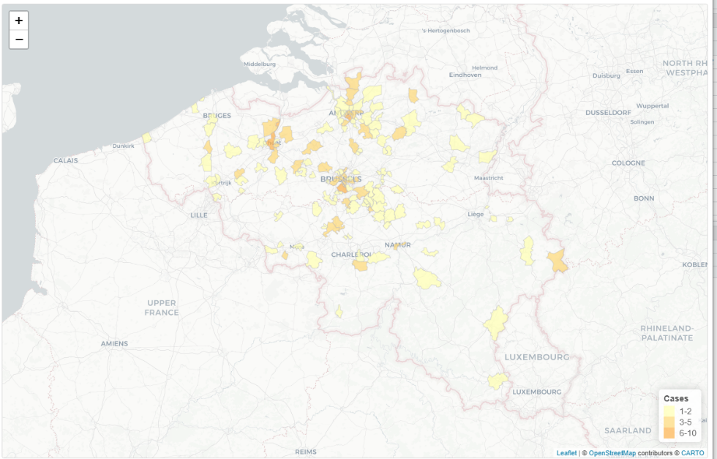
Dengue cases 2023: colours acc. number of cases

Slide 10
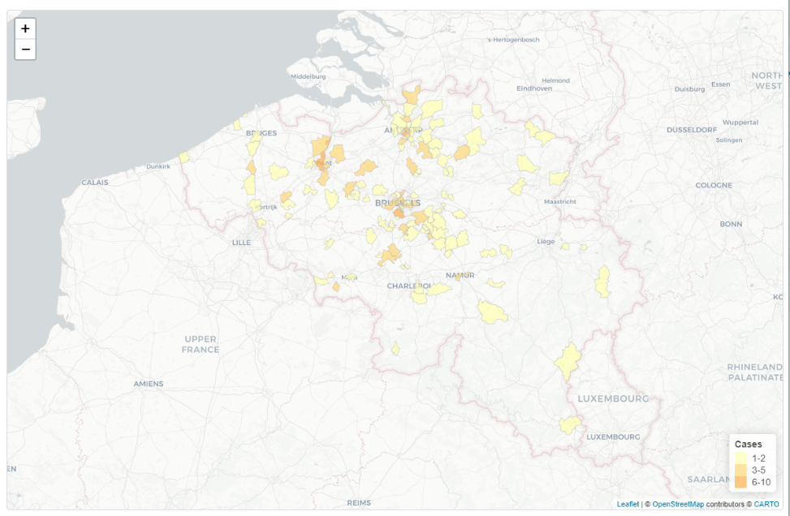
Dengue cases 2023 (May-Oct): colours acc. number of cases

Slide 11
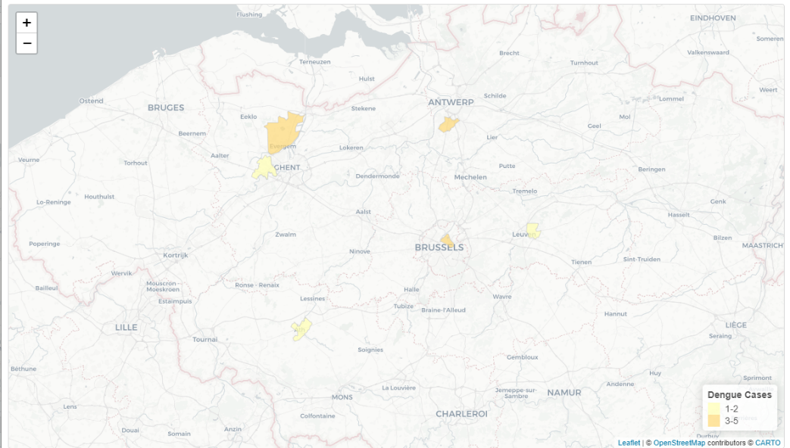
Spatial overlaps 2023: Dengue infections (May-Oct) and Aedes albopictus detections 2023 (scenario 1)

Slide 12
Design prevention and/or control strategy to avoid/limit arbovirus transmission
Where and when to act? Pro-active or reactive control strategy?
Reactive = control reactive to a risk
Control measures:
Target the (infected) mosquitoes – mainly adult mosquito control,
Also to include larval control and source reduction
Reduce human-vector contact case and householdmembers (? Broader?): repellents, …
Targeted actions for travellers to protect themselves while travelling and after return

Slide 13
Design prevention and/or control strategy to avoid/limit arbovirus transmission
Where and when to act? Pro-active or reactive control strategy?
Reactive = control when case and mosquito overlap temporally and spatially
Challenges:
What radius to take for spatial overlap? What time-lag to take for temporal overlap?
Cases are confirmed, most likely when viremic phase is already over
Speed of action: If going to house of case quickly, infected adult mosquitoes could be killed to avoid further transmission (+/-12 days window from bite infected person to be infective; afterwards +/-14 days window infective mosquito)
but how quick a mosquito-control measure can be put in place in that house?
Movement: Cases (especially pauci-symptomatic) are moving during day-time, and can contaminate mosquitoes outside the house-neighboorhood
which radius to take around house for control?
To detect overlap case/mosquito also in work-places of case? Hobby/sport/family places?

Slide 14
Design prevention and/or control strategy to avoid/limit arbovirus transmission
Where and when to act? Pro-active or reactive control strategy?
Pro-active = prevention
Principle of decreasing mosquitoes in areas where - and a time window just before - we expect to have highest potential risk of transmission
Targeting according Risk:
Aedes: current (last year)? historical (Last x years?)?
Import cases? Historical? not so important (as many are not diagnosed/asymptomatic)
Historical overlaps cases-mosq? Historical case-mosq seasonal overlaps?
Control measures:
Mainly larval control (decrease density) and source reduction
General messages/actions for travelers to protect themselves while travelling and after return

Slide 15
Where to act in 2024 (today) if to apply preventive control?

Slide 16

Pro-active control: Cumulative mosquitoes over the last 5 years: indication of places being once/twice/3x/4X or 5x positive for presence of Aedes albopictus scenario 1 and 2

Slide 17
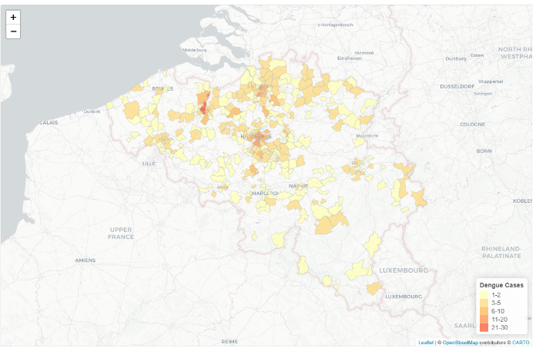
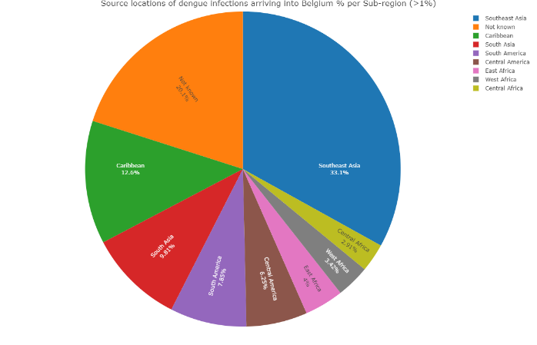
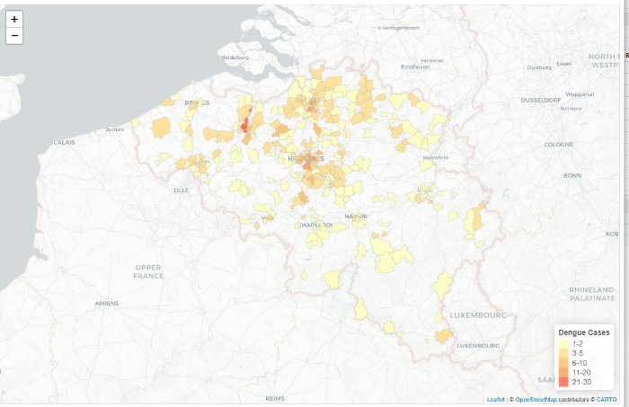
Cumulative dengue cases over the last 5 years: colours acc. number of cases
Idem cases May-October

Slide 18
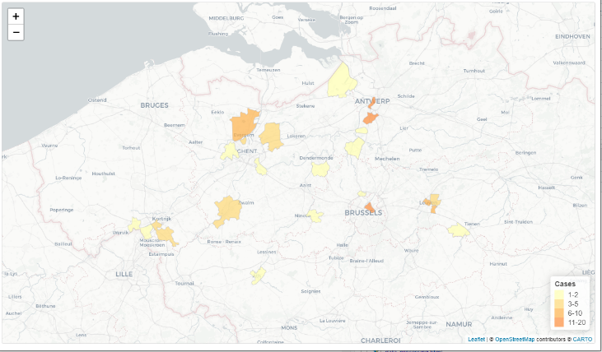
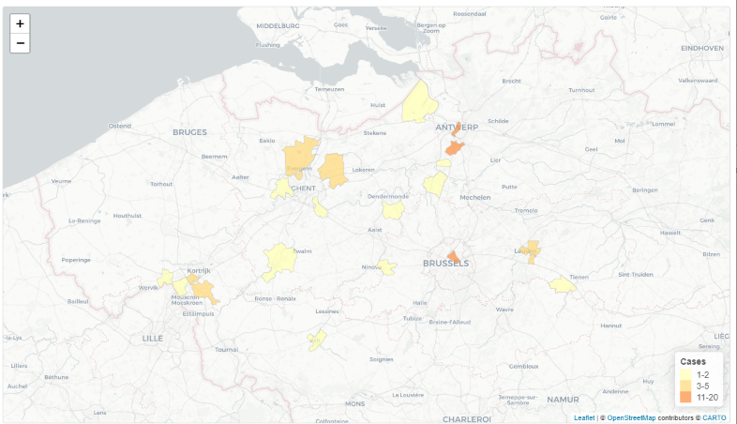
Overlap: Cumulative cases (5 years) in post codes where Aedes albopictus has been detected at least once in past 5 years
Idem cases May-October

Slide 19
Preliminary advice
Reactive control when import case is within radius of 300m (less??, more??) of mosquito detection in scenario 2 place:
*Case (suspect + confirmed):
Stay at home
Avoid contact with mosquitoes (repellents, spatial repellents)
*Breeding site control (BTI) (? Radius of action (150-200m)//coverage of action?)
Peri-domestic spraying (? Radius of action (150-200 m)//coverage of action?)
To consider:
(aspirations of adult mosquitoes in the area before start spraying)
Revision for aedes + if positive, Control (peri-domestic spraying), of places where confirmed case was present during viremic phase (7-10 days after start of fever)
? Scenario 1 places? – need for dashboard: real time import cases (PCR + ? IgM +?); Aedes real time + last year
Pro-active control in scenario 2 areas
*=minimal actions

Slide 20
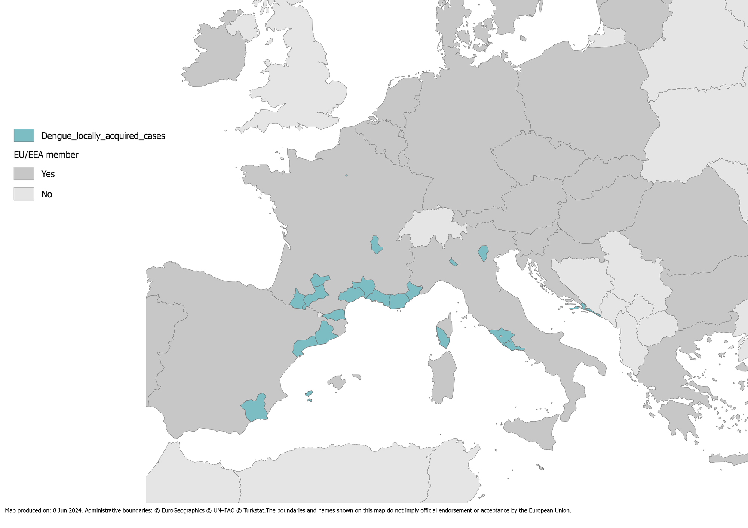
Locally acquired cases Europe in past 10 years (scenario 4)

Slide 21
Design prevention and/or control strategy to avoid/limit arbovirus transmission
What to do?
Aedes-density control (targeting larvae)
Aedes-longevity control (targeting ‘infected’ adult mosquitoes)
Human-vector contact control
Of ‘cases’ (to avoid transmission of virus to an introduced/established Aedes albopictus mosquito)
Of ‘all’ (to avoid that an infected mosquito bites a non infected person)
Control/decrease import arbovirus-cases (> dengue)

Slide 22
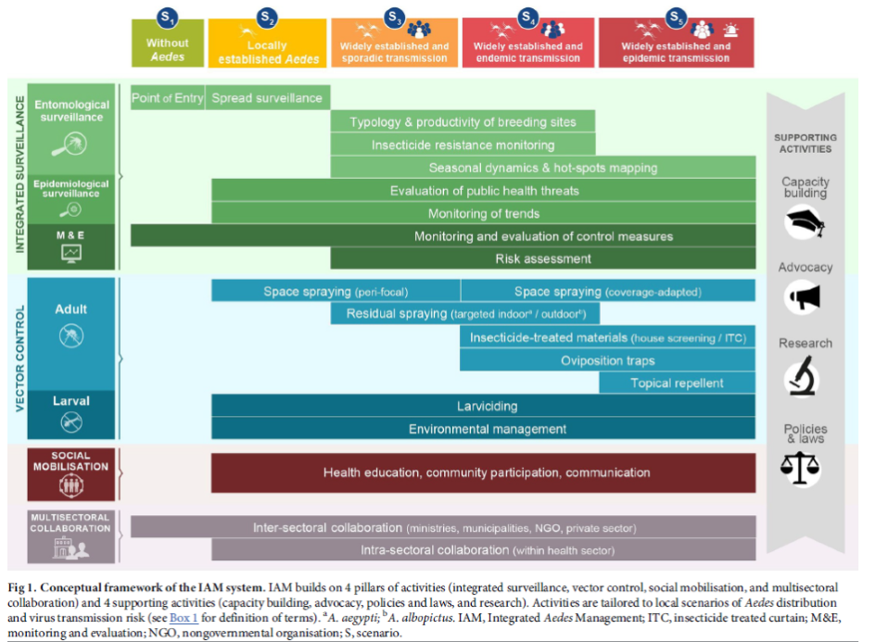
Framework to summarize EU country plans
France
Germany
Greece
Italy
Spain
Netherlands
Switzerland
UK
Roiz et al, 2018

Slide 23
What scenarios should we be preparing for?
FRANCE

Slide 24
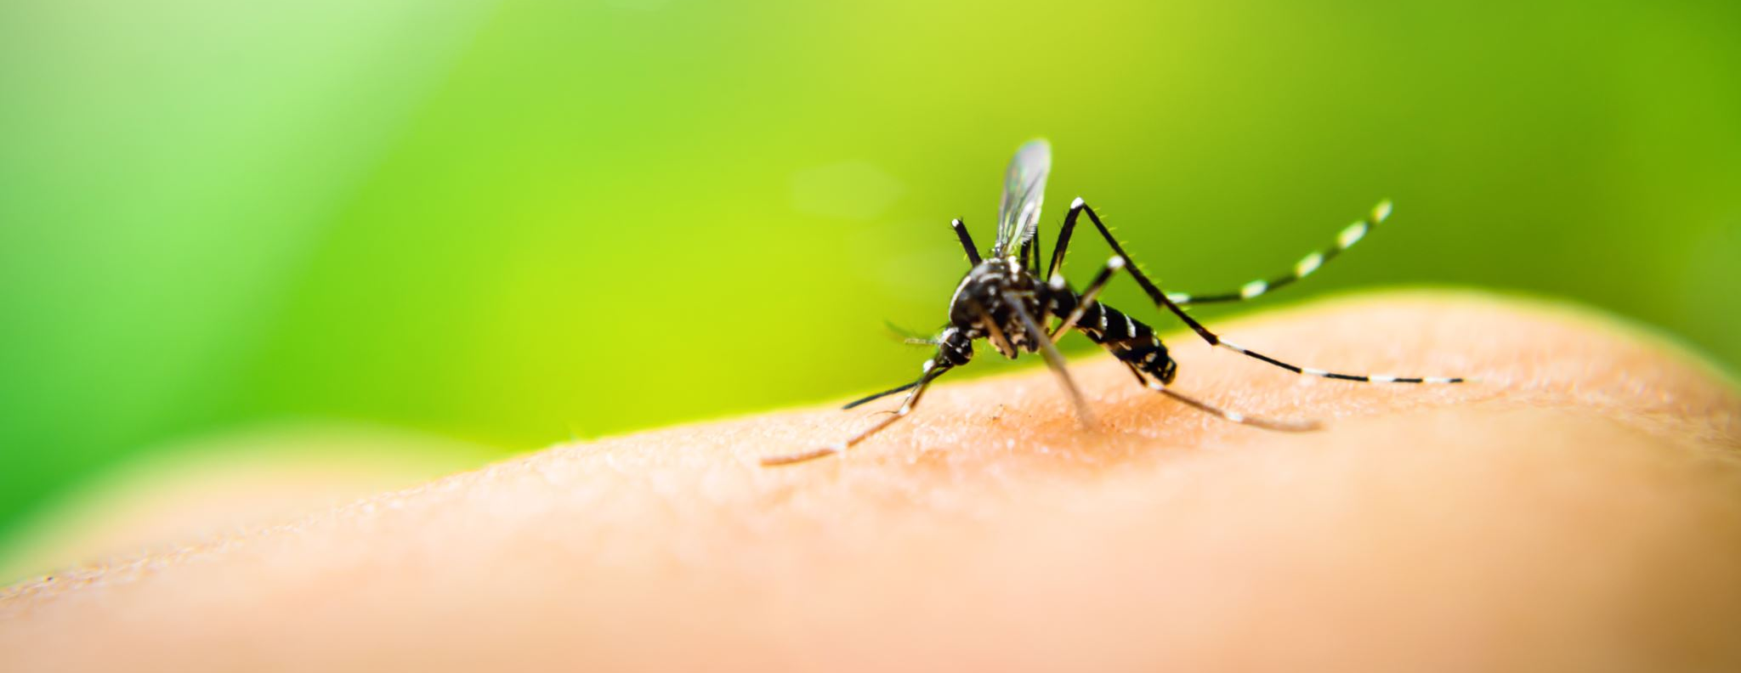
How is Dengue control currently managed in France?

Slide 25
ACTIVITIES CARRIED OUT IN FRANCE TO CONTROL DENGUE
Integrated Surveillance | Entomological Surveillance | Trapping esp. gravid traps Insect resistance monitoring
 | Epi. Surveillance | Systematic testing of suspected cases Investigations carried out for each imported & autochthonous case Active case finding by searching of database of major laboratories platforms everyday AUTHOCHTHONOUS CASE: Active case finding: Door-to-door survey in radius of 150-250m, finger prick test for suspected, contact with health professionals
 | M&E | Monitoring autochtonous/imported case notifications from laboratory, tiger mosquito spotting etc through online platform SI-LAV
Vector Control | Adult | Truck cold fogging (+backpack if authochthonous) with pyrethroids Traps using CO2 attractants Skin and spatial repellents Bednets for babies and people with viraemia Oviposition traps
 | Larval | Destruction of larval breeding sites (private & public property) Larviciding with BTI (& BS)
 | Social mobilisation | Awareness campaigns at the start of the season (May - Nov) Info campaigns for health professionals & population in case of autochthonous case Sensitisation in schools
 | Multisectoral collaboration | Present. Between municiaplities, health professionals, ministry of health, individuals etc

Slide 26
Which control methods are currently used by the other EU countries or could be interesting ?
Target | Type of method | Tools
Immature | Biological | BTI
 |  | BS (in combination with BTI= Vectomax)
 |  | Predators eg fish, copepods
 | Chemical | IGR (Growth regulators)
 | Environmental | Destruction of breeding sites
 |  | Mechanical protection – Polydimethylsiloxane(PDMS) vs Oil
Adult | Biological | SIT (Sterile males introduction)
 |  | Wolbachia
 |  | Mass trapping
 | Chemical | Fogging - street/ground, peri-domestic
 |  | Mass trapping
 |  | ORS (Outdoor Residual spraying)
Personal barriers |  | Skin repellent
 |  | Spatial repellents ie vaporizers, serpentines
 |  | Screens/Bednets

Slide 27
To review systematic reviews: Which reviews are existing? Quick search:

Slide 28
Are spatial repellents effective? What does the evidence say?
(Achee et al, 2023¹) reports significant reduction in indoor Ae. aegypti abundance and blood feeding was found
(Spatial Repellents Report, 2020²) reports that spatial repellents of both pyrethroid and non-pyrethroid origin have shown proven effective in majority of lab and field trials

Slide 29
Are spatial repellents safe
Insufficient evidence in the literature to declare them safe or unsafe³

Slide 30
Questions/discussion points meeting 17/06/2024
Reactive? How quickly can we react? What is the best strategy?
Definition of ‘risk’ for pro-active and reactive strategy

Slide 31


Slide 32
References
Montenegro-Quiñonez, Carlos Alberto et al, (2023). Interventions against Aedes/dengue at the household level: a systematic review and meta-analysis. eBioMedicine, Volume 93, 104660
Logan J, Chen-Hussey V, O’Halloran L, Greaves C, Due C, Macdonald M, (2020). An Expert Review of Spatial Repellents for Mosquito Control (efaidnbmnnnibpcajpcglclefindmkaj/https://www.ivcc.com/wp-content/uploads/2020/08/An-Expert-Review-of-Spatial-Repellents-for-Mosquito-Control.pdf)
VITO, (2024). Muggenwerende middelen en gezondheid

Slide 33
Extra informatie
Een mug leeft ongeveer 1 maand;
Tussen iedere bloedmaaltijd zijn er ongeveer 2-3 dagen (gonotrofische cyclus), maar Aedes muggen nemen dikwijls meerdere bloedmaaltijden per gonotrofische cyclus.
De EIP varieert afhankelijk van het virus:
Voor DENV is dat tss 10-12 dagen
Voor CIKV kan dat slechts drie dagen zijn
Voor ZIKV rond de 14 dagen

